Slide 1
DATA STRUCTURE & ALGORITHM
Chapter 07 -
Linked List

Slide 2
Objectives
At the end of the class, students are expected to :
● Describe linear list concepts using array and linked list.
● Able to lists variations of linked list and basic operations of linked lists.
● Able to explain in detail the implementation and operations of link lists using pointers.
● Able to write program that can implement linked list concept.
2

Slide 3
Introduction
Lists Definition
● Lists is a group of objects which is organized in sequence.
● List categories: linear list and nonlinear list.
● Linear list – a list in which the data is organized in sequence, example: array, linked list, stack and queue
● Non-Linear list – a list in which the data is stored not sequence, example: tree and graph
3

Slide 4
Introduction to Linear List
● Array and linked lists are linear lists that doesn’t have any restrictions while implementing operations such as, insertion, deletion and accessing data in the lists.
● The operations can be done in any parts of the lists, either in the front lists, in the middle or at the back of the lists.
● Stack and queue is a linear lists that has restrictions while implementing its operations.
● Stack – to insert, delete and access data can only be
done at the top of the lists.
● Queue - Insert data in a queue can be done at the back of the lists while to delete data from a queue can only be done at the front list.
4

Slide 5
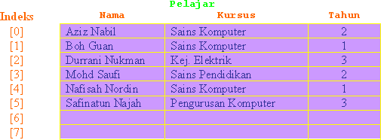
Introduction to Linear List
● An array named Pelajar which contains attributes nama pelajar,
kursus and tahun Pelajar.
● The array is sorted and can only be accessed based on the index or subscript of the array.
● Example: to access information for a student named Mohd Saufi, we
can use:
Pelajar[3].Nama, Pelajar[3].Kursus dan Pelajar[3].Tahun.
5

Slide 6
Introduction to Linear List
● Linked lists which contain several nodes which is sorted in ascendeng order.
● Each node contains at least
● A piece of data (any type)
● Pointer to the next node in the list
● Need pointer variable Head [Senarai]: to point to the first node
6

Slide 7
Introduction to Linear List
● Basic operations for linear lists:
● Insert new data in the lists.
● Delete data from a lists.
● Update data in the list.
● Sort data in the lists and
● Find data in the list.
7

Slide 8
Array as linear list
● Sized is fixed during array declaration.
● Data insertion is limited to array size
● In order to insert data, need to check whether the array is full or not. If the array is full, the insertion cannot be done.
8

Slide 9
Array as linear list
● Data in the array can be accessed at random using the index of the
array.
● Example, if we access Nama, Kursus and Tahun for Pelajar[3] information of Pelajar[3], Mohd Saufi taking Sains Pendidikan course and in year 2 will be given.
● By random access, accessing data in an array can be done faster.
9

Slide 10
Array Implementation ... the drawbacks
● Requires an estimate of the maximum size of the list
➢ waste space
● printList and find: linear access
● findKth: constant
● insert and delete: slow
● insert at position 0 (making a new element)
requires first pushing the entire array down one spot to make room
● delete at position 0
requires shifting all the elements in the list up one
● On average, half of the lists needs to be moved for either operation
10

Slide 11

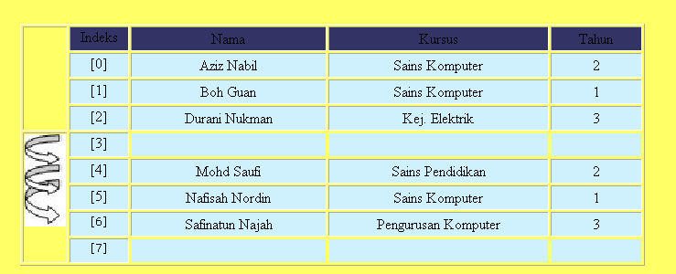
Array Implementation ... the drawbacks
.
● Need space to insert item in the middle of the list.
● Insert Fatimah Adam in between students named Durrani Nukman and Mohd Saufi.
● insert at index 3 : requires first pushing the entire array from index 3 down one spot to make room

Slide 12
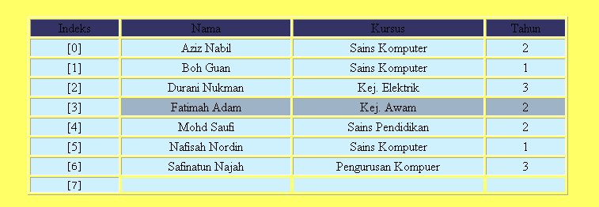
Array Implementation ... the drawbacks
New item is inserted at index 3, after shifting the data from index 3 onwards. .

Slide 13
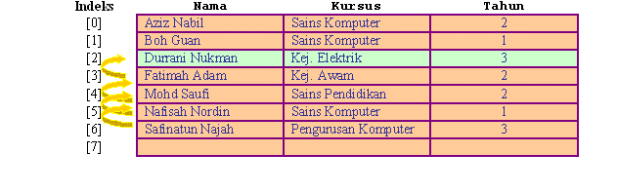
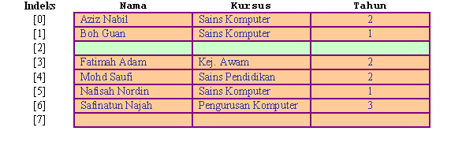
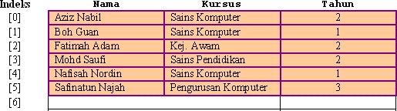
Array Implementation ... the drawbacks
To delete item in the middle of the array will leave a blank space in the middle.
It requires shifting all the elements in the list up one in order to eliminate the space..
Example: when information about Durrani Nukman is deleted, all elements below it, is shifted up.

Slide 14
Pointer Implementation (Linked List)
● Ensure that the list is not stored contiguously
● use a linked list
● a series of structures that are not necessarily adjacent in memory
Each node contains the element and a pointer to a structure containing its successor
the last cell’s next link points to NULL
Compared to the array implementation,
the pointer implementation uses only as much space as is needed for the elements currently on the list
but requires space for the pointers in each cell

Slide 15
Linked list variations
● Singly linked list
● Doubly linked list
● Circular linked list
● Circular doubly linked list
● Sorted linked list
● Unsorted linked list
15

Slide 16
Singly Linked Lists
A
B
C

Head
● A linked list is a series of connected nodes
● Each node contains at least
● A piece of data (any type)
● Pointer to the next node in the list
● Head: pointer to the first node
● The last node points to NULL
node
A
data
pointer
16

Slide 17
Variations of Linked Lists
● Circular linked lists
● The last node points to the first node of the list
A
B
C
Head
● How do we know when we have finished traversing the list? (Tip: check if the pointer of the current node is equal to the head.)

Slide 18
Variations of Linked Lists
● Doubly linked lists
● Each node points to not only successor but the predecessor
● There are two NULL: at the first and last nodes in the list
● Advantage: given a node, it is easy to visit its predecessor. Convenient to traverse lists backwards

A
B
C

Head

Slide 19

Variations of Linked Lists
Circular doubly linked list
● No NULL value at the first and last nodes in the list
● Convenient to traverse lists backwards and forwards

Slide 20
Variations of Linked Lists
Sorted Linked list :
The nodes in the lists is sorted in certain order.
D
F
K

Head
UnSorted Linked list :
The nodes in the lists is not sorted in any order.
W
M
P

Head

Slide 21
LINK LIST IMPLEMENTATION

Slide 22
Linked List Implementation
● We need two classes: Node and List
● Declare Node class for the nodes which contains data and next: a pointer to the next node in the list
class Node {
public:
double data; Node* next;
};
data next
// data
// pointer to next node
4.5

Slide 23
Example : Declaring a node for class account
Create a node for class account using struct
struct nodeAccount {
char accountName[20]; char accountNo[15]; float balance; nodeAccount *next;
};
accountName | accountNo | balance | next
Ahmad Ali | 1234567 | 10,000.00

Slide 24
Exercise – Declaring a node
bookTitle | ISBNno | price | next
Link List Guide | 1234- 5678 | 40.00 | NULL
Figure above represents a node in a link list that store information for book.
The node consists of the following attributes :
bookTitle, ISBNno, price and pointer next.
Write a class/struct declaration for the node that is able
to store the information.

Slide 25
A Simple Linked List Class
● Declare List, which contains
● head: a pointer to the first node in the list.
Since the list is empty initially, head is set to NULL
● Operations on List
class List { public:
List(void) { head = NULL; }
~List(void);
// constructor
// destructor
bool IsEmpty() { return head == NULL; }
Node* InsertNode(double x); int FindNode(double x);
int DeleteNode(double x); void DisplayList(void);
private:
Node* head;
};
25

Slide 26
A Simple Linked List Class
Operations of List
● IsEmpty: determine whether or not the list is empty
● InsertNode: insert a new node at a particular position
● FindNode: find a node with a given value
● DeleteNode: delete a node with a given value
● DisplayList: print all the nodes in the list

Slide 27
Inserting a new node
● Node* InsertNode(double x)
● Insert a node with data equal to x. After insertion, this function generates a sorted list : in ascending order.
● Find the location of the value to be inserted so that the value will be in the correct order in the list. (i.e., when index = 0, insert the node as the first element;
when index = 1, insert the node after the first element, and so on)
● Steps
index’th
1. Locate position to insert the element^{element}
2. Allocate memory for the new node
3. Point the new node to its successor
4. Point the new node’s predecessor to the new node
newNode

Slide 28
Inserting a new node
● Possible cases of InsertNode
1. Insert into an empty list
2. Insert in front
3. Insert at back
4. Insert in middle
● But, in fact, only need to handle two cases
● Insert as the first node (Case 1 and Case 2)
● Insert in the middle or at the end of the list (Case 3 and Case 4)

Slide 29
Inserting a new node (will create a sorted list)
Node* List::InsertNode(double x) {
Try to locate the
index of the
int currIndex = Node* currNode = Node* prevNode =
0;
head; NULL;
> currNode->data) {
node being
inserted.
while (currNode && x
prevNode = currNode; currNode = currNode->next; currIndex++;
}
Node* | newNode | = | new | Node;
newNode->data = |  |  | x;
if (currIndex == 0) {
newNode->next |  |  | = | head;
head |  |  | = | newNode;
}
else {
newNode->next |  |  | = | prevNode->next;
prevNode->next =
newNode;
}
return newNode;
29
}

Slide 30
Inserting a new node
Node* List::InsertNode(double x) {
int currIndex = Node* currNode = Node* prevNode =
0;
head; NULL;
> currNode->data) {
while (currNode && x
prevNode = currNode; currNode = currNode->next; currIndex++;
}
Node* newNode =
newNode->data =
new
x;
Node;
if (currIndex == 0) {
newNode->next = head =
}
else {
head; newNode;
Create a new node
newNode->next
prevNode->next
=
=
prevNode->next;
newNode;
}
return newNode;
30
}

Slide 31
Inserting a new node
Node* List::InsertNode(double x) {
int currIndex = Node* currNode = Node* prevNode =
0;
head; NULL;
> currNode->data) {
while (currNode && x
prevNode = currNode; currNode = currNode->next; currIndex++;
}
Node* newNode =
newNode->data =
new
x;
Node;
Insert as first element
if (currIndex == 0) {
newNode->next = head =
}
head
head; newNode;
else {
newNode->next
prevNode->next
=
=
prevNode->next;
newNode;
newNode
}
return newNode;
31
}

Slide 32
Inserting a new node
Node* List::InsertNode(double x) {
int currIndex = Node* currNode = Node* prevNode =
0;
head; NULL;
> currNode->data) {
while (currNode && x
prevNode = currNode; currNode = currNode->next; currIndex++;
}
Node* newNode =
newNode->data =
new
x;
Node;
Insert after prevNode
if (currIndex == 0) {
newNode->next = head =
}
prevNode currNode
head; newNode;
else {
newNode->next =
prevNode->next;
prevNode->next =
newNode;
newNode
}
return
newNode;
32
}

Slide 33
Inserting a new node at certain index (will create unsorted list)
Node* List::InsertNode(int index, double x) {
Try to locate
if (index < 0) return NULL;
index’th node. If it
doesn’t exist,
return NULL.
int currIndex = Node* currNode =
1;
head;
while (currNode && index > currIndex) { currNode = currNode->next; currIndex++;
}
if (index > 0 && currNode == NULL) return NULL;
Node* newNode = newNode->data =
new Node; x;
if (index == 0) {
newNode->next = head =
}
else {
newNode->next =
head; newNode;
currNode->next;
currNode->next =
newNode;
}
return newNode;
33

Slide 34
Inserting a new node
Node* List::InsertNode(int index, double x) { if (index < 0) return NULL;
int currIndex = Node* currNode =
1;
head;
while (currNode && index > currIndex) { currNode = currNode->next; currIndex++;
}
if (index > 0 && currNode == NULL) return NULL;
Node* newNode = newNode->data =
new Node; x;
if (index == 0) {
newNode->next = head =
}
else {
head; newNode;
Create a new node
newNode->next
currNode->next
=
=
currNode->next;
newNode;
}
return newNode;
34

Slide 35
Inserting a new node
Node* List::InsertNode(int index, double x) { if (index < 0) return NULL;
int currIndex | = | 1;
Node* currNode | = | head;
while (currNode && index > currIndex) {
currNode = |  |  |  | currNode->next;
currIndex++;
}
if (index > 0 && currNode |  |  | == | NULL) return NULL;
Node* newNode = newNode->data =
new x;
Node;
Insert as first element
if (index == 0) {
newNode->next = head =
}
head
head; newNode;
else {
newNode->next
currNode->next
=
=
currNode->next;
newNode;
newNode
}
return newNode;
35

Slide 36
Inserting a new node
Node* List::InsertNode(int index, double x) { if (index < 0) return NULL;
int currIndex | = | 1;
Node* currNode | = | head;
while (currNode && index > currIndex) {
currNode = currIndex++; } if (index > 0 && currNode |  |  | == | currNode->next; NULL) return NULL;
Node* newNode newNode->data | = = | new x; | Node;
if (index == 0) {
newNode->next = head =
}
head; newNode;
Insert after currNode
else {
currNode
newNode->next =
currNode->next;
currNode->next =
newNode;
}
return
newNode;
newNode
36

Slide 37
Finding a node
● int FindNode(double x)
● Search for a node with the value equal to x in the list.
● If such a node is found, return its position. Otherwise, return 0.
int | List::FindNode(double | x) {
 | Node* currNode | = | head;
 | int currIndex = | 1;
while (currNode && currNode->data != x) {
currNode = currIndex++;
}
if (currNode)
return currIndex;
else
return 0;
currNode->next;
}
37

Slide 38
Deleting a node
● int DeleteNode(double x)
● Delete a node with the value equal to x from the list.
● If such a node is found, return its position. Otherwise, return 0.
● Steps
● Find the desirable node (similar to FindNode)
● Release the memory occupied by the found node
● Set the pointer of the predecessor of the found node to the successor of the found node
● Like InsertNode, there are two special cases
● Delete first node
● Delete the node in middle or at the end of the list
38

Slide 39
Deleting a node
int List::DeleteNode(double x) {
Try to find the node with
Node* prevNode = Node* currNode = int currIndex =
NULL;
head; 1;
its value equal to x
while (currNode && currNode->data != x) {
prevNode currNode currIndex++;
=
=
currNode; currNode->next;
}
if (currNode) {
if (prevNode) {
prevNode->next = delete currNode;
}
else {
head =
delete currNode;
currNode->next;
currNode->next;
}
return currIndex;
}
return 0;
39

Slide 40
Deleting a node
int List::DeleteNode(double x) {
Node* prevNode = Node* currNode = int currIndex =
NULL;
head; 1;
while (currNode && currNode->data != x) {
prevNode currNode currIndex++;
=
=
currNode; currNode->next;
prevNode currNode
}
if (currNode) {
if (prevNode) {
prevNode->next = delete currNode;
}
else {
head =
delete currNode;
currNode->next;
currNode->next;
}
return currIndex;
}
return 0;
}
40

Slide 41
Deleting a node
int List::DeleteNode(double x) {
Node* prevNode = Node* currNode = int currIndex =
NULL;
head; 1;
while (currNode && currNode->data != x) {
prevNode currNode currIndex++;
=
=
currNode; currNode->next;
}
if (currNode) {
if (prevNode) {
prevNode->next = delete currNode;
}
currNode->next;
else {
head = currNode->next;
delete currNode;
head
currNode
}
return currIndex;
}
return 0;
}
41

Slide 42
Printing all the elements
● void DisplayList(void)
● Print the data of all the elements
● Print the number of the nodes in the list
void List::DisplayList()
{
int num =
Node* currNode =
0;
head;
while (currNode != NULL){
cout << currNode->data << endl; currNode = currNode->next; num++;
}
cout << "Number of nodes in the list: " << num << endl;
}

Slide 43
Destroying the list : ~List()
● Use the destructor to release all the memory used by the list.
● Step through the list and delete each node
one by one.
List::~List()
{ Node* currNode = head, *nextNode = NULL; while (currNode != NULL)
{ nextNode = currNode->next;
// destroy the current node delete currNode;
currNode = nextNode;
}
head = Null;
}

Slide 44
result
4
5
6
7
Using List
Number of nodes in the list: 4
5.0 found
4.5 not found
int | main(void)
{
 | List list;
 | list.InsertNode(7.0); | // | successful
 | list.InsertNode(5.0); | // | successful
 | list.InsertNode(6.0); | // | successful
 | list.InsertNode(4.0); | // | successful
// print all the elements list.DisplayList();
4
5
6
Number of nodes in the list: 3
if(list.FindNode(5.0) else | > 0) cout cout | << << | "5.0 "5.0 | found" << endl; not found" << endl;
if(list.FindNode(4.5) | > 0) cout | << | "4.5 | found" << endl;
else | cout | << | "4.5 | not found" << endl;
list.DeleteNode(7.0);
list.DisplayList();
return 0;
}

Slide 45
● Linked lists are more complex to code and manage than arrays, but they have some distinct advantages.
Dynamic: a linked list can easily grow and shrink in size.
We don’t need to know how many nodes will be in the list. They are created in memory as needed.
In contrast, the size of a C++ array is fixed at compilation time.

Slide 46
Easy and fast insertions and deletions
To insert or delete an element in an array, we need to copy to temporary variables to make room for new elements or close the gap caused by deleted elements.
With a linked list, no need to move other nodes. Only need to reset some pointers.

Slide 47
Linked List - Conclusion
● Try make your own conclusion by comparing array list and linked list in term of:
● Size of items/nodes in the list
● Add new items/nodes at the beginning or in the middle of the list
● Delete items at the beginning or in the middle of the list
● Get items at nodes n

Slide 48
Lab Exercise
● Write a complete link list program based on the implementation of the following classes and functions given in the notes.
● Class Node and List
● Constructor and Destructor
● IsEmpty(),InsertNode(), FindNode() DeleteNode() and DisplayList()
● Provide main() program to execute the list.

Slide 49
Thank You

